Slide 1
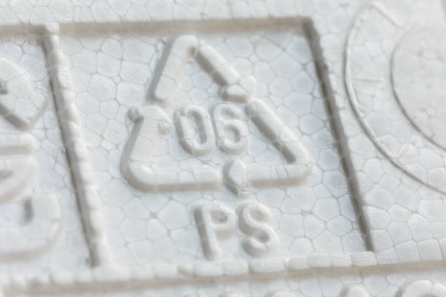
SPECIAL LIST - PAD
EPS – Expanded polystyrene foam
Manufacturing process
Agenda:
Introduction
EPS foam manufacturing process
Troubles
VE ideas
Present by: Doan Duy Toan
Comment by: Vu Thanh Son

Slide 2
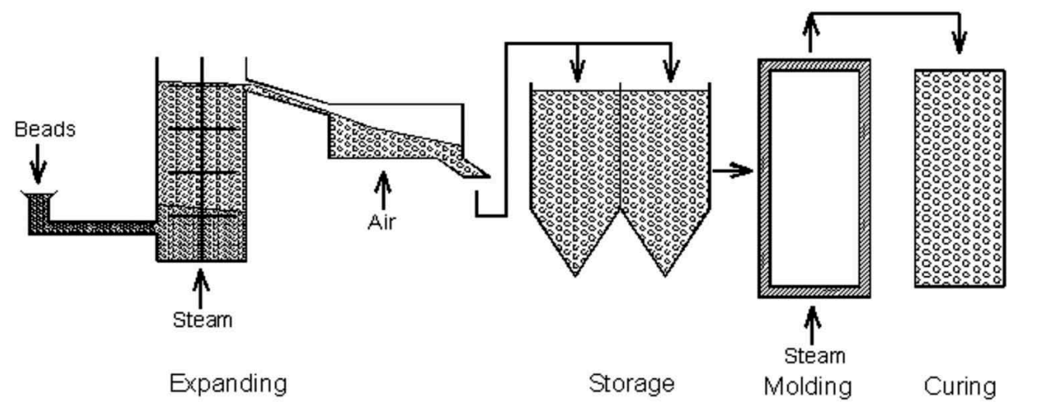
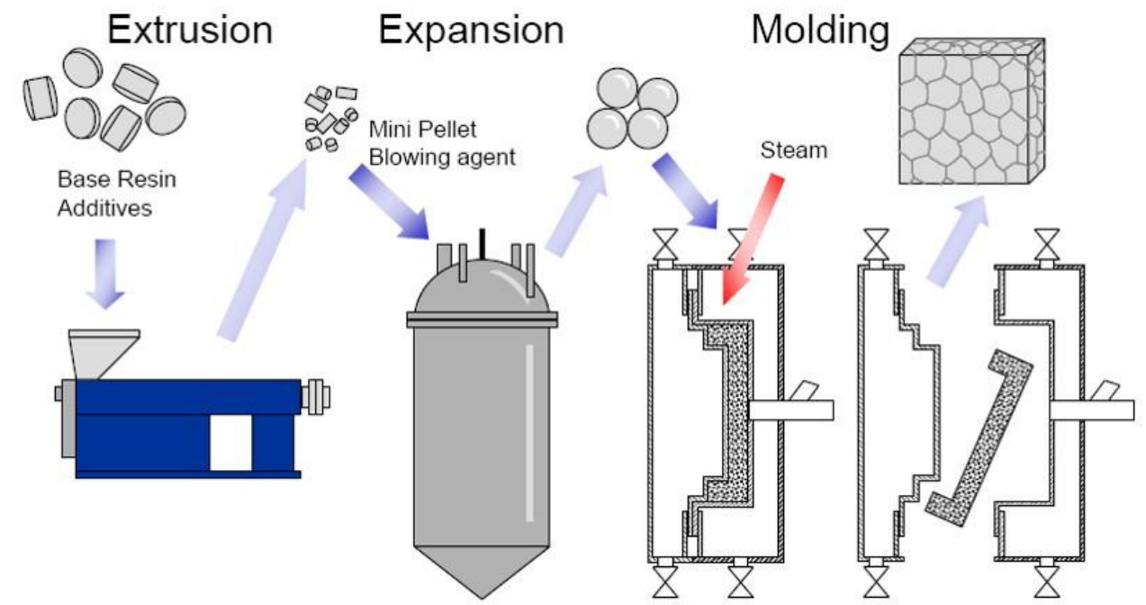
II. EPS foam manufacturing process

Slide 3
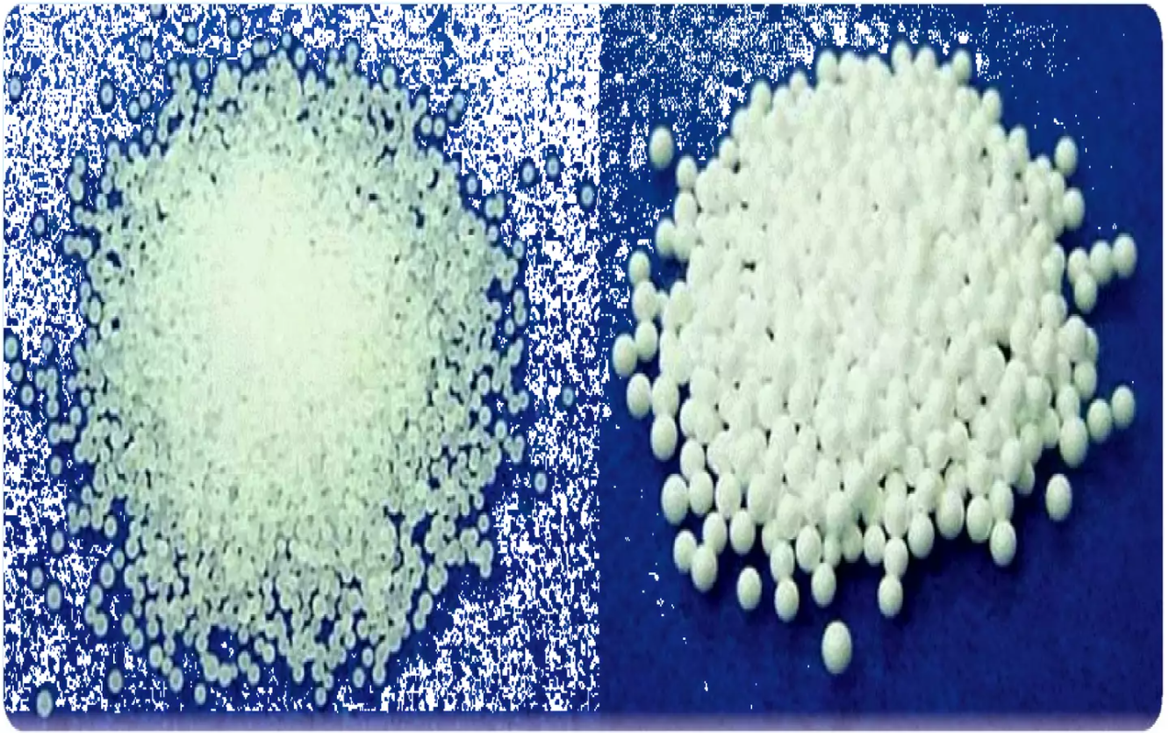
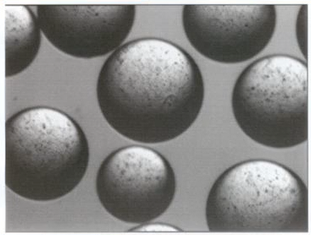
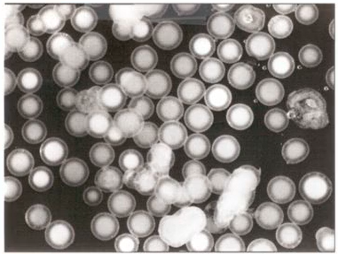
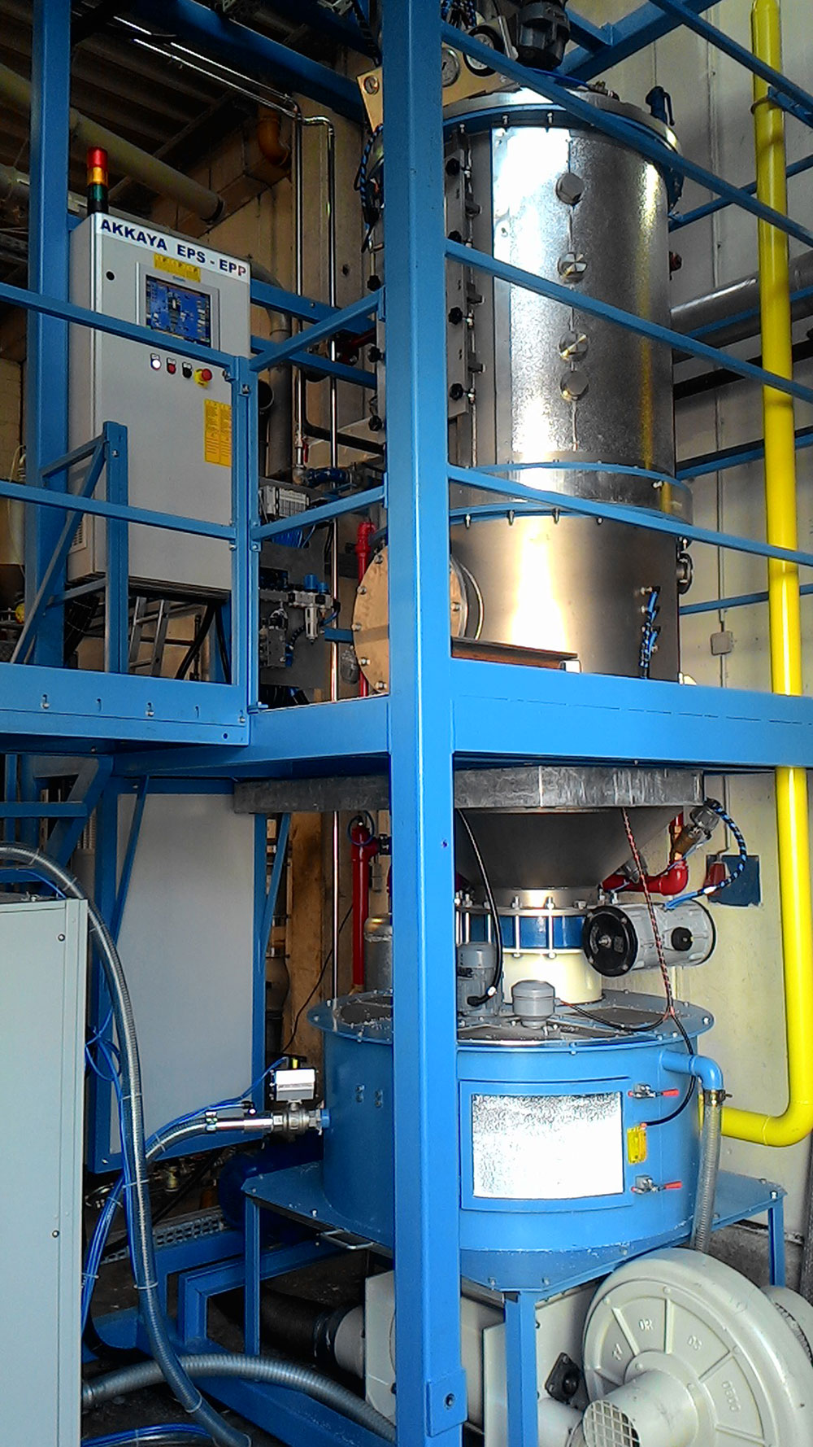
II. EPS foam manufacturing process
1. Pre-expanded
- Purpose: To expand the raw material’s compact beads to desired magnification.
- Principle of operation:
Resin
Weighing
Expansion chamber - steam
94% PS – 4% pentane
Aging
1st beads
Fluid bed dryer - air
A pre-weighed quantity of material is dropped into the expansion chamber where the steam is injected.
An agitator keeps material moving to prevent them from fusing together.
Time: about 1h30m
- Expansion controls:
Blowing agents begin to vaporize
Glass transition temperature (Tg)
Expansion proceed rapidly
Bead’s wall begin to rupture
0ºC
28ºC
49ºC
85ºC
100ºC
110ºC
125ºC
Pre-expanded machine
Notes:
The first temperature range from 28 to 49.
Move on to the next point, 85 degrees Celsius, this is when the grain starts to soften, we call it the glass transition temperature - it mean bead will change status from solid to rubber.
The next temperature range is from 100 to 110, During this range, the expansion proceeds rapidly, the size of the bead increases to 40 or 50 times.

Slide 4
II. EPS foam manufacturing process
2. Aging
- Purpose: remove internal moisture, balance pressure of interal and external.
- Principle of operation:
3->72h
1st beads
Maturing and stabilizing
Mold
After pre-expansion, 1st bead was transport to Silos by pneumatic tubes.
Time to full fill 1 Silo: about 13->15cycle time of pre-expansion.
Need aging at least 1h (good condition: 6->8h).
94% PS – 4% pentane
Pre-expanded machine

Slide 5
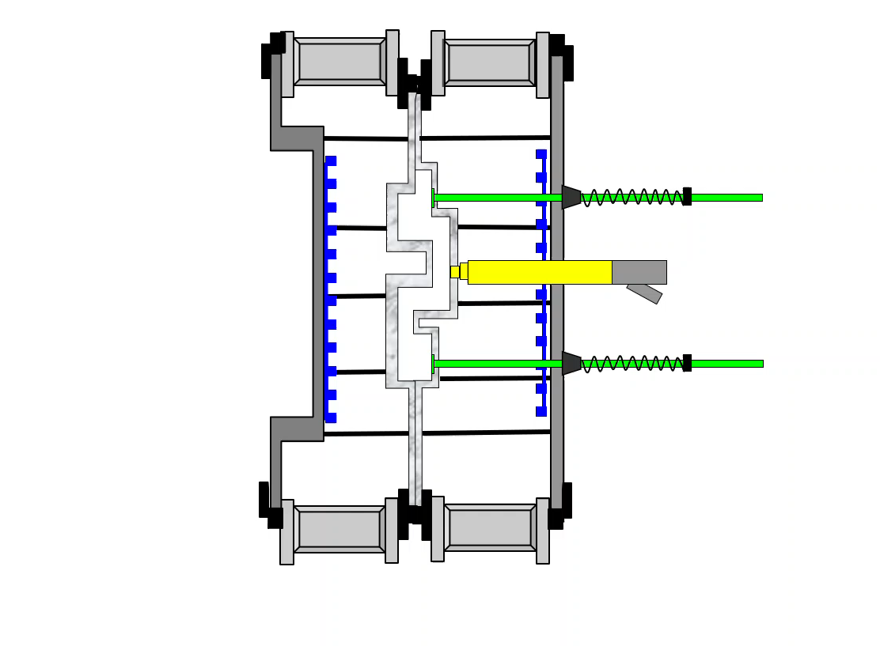
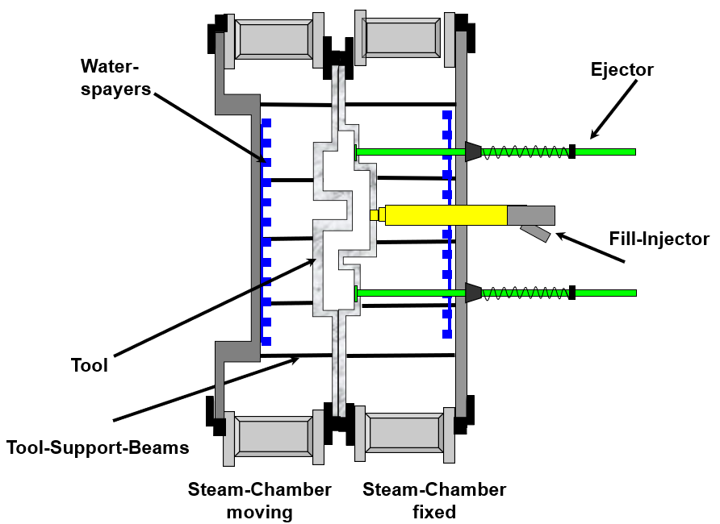
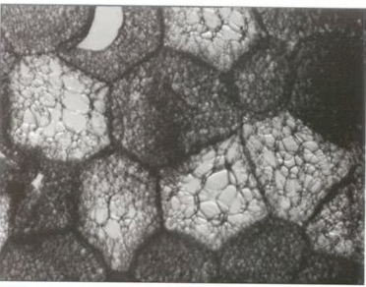
II. EPS foam manufacturing process
1. Molding
- Purpose: remove internal moisture, balance pressure of interal and external.
1st beads
2nd beads
Feeding
Steaming
Shaping
Cooling
Ejection
Notes:
Expanded bead fills the mold cavity via pneumatic filling tubes. And we have holes on the mould walls to connect the mold with the steam chamber. Steam is applied to the EPS bead cavity of the mold. The steam causes the beads to soften again and to expand. The expansion pressure (around 1 bar) compresses the beads against each other and at the same time forces them against the mold walls so that they fuse together. The resultant part is then cooled by spraying water onto the mould and by applying a vacuum. When cooled down enough, the final molded part can be taken from the mould.

Slide 6
Ensure that the material is dimensionally stable and provides a completely, dry material for best fabrication results.
Store the EPS foam under the roof, away from high winds and direct sunlight.
Be careful with flammable materials such as paints, solvents or petroleum products.
Smoking is prohibited in the storage area and the product should not be exposed to open flames or other ignition sources.

